Slide 1

Aegis: A Semantic Implementation of Privacy as Contextual Integrity in Social Ecosystems
Imrul Kayes, Adriana Iamnitchi

Slide 2
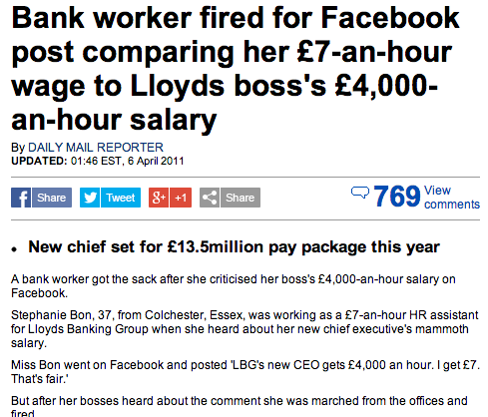


Social Privacy Risks

Slide 3
Why Does This Happen?
Inappropriate sharing and transferring of information
(Permissive) Default privacy settings by OSN provider
Because they can
Lack of universal framework that establishes what is right and wrong
Users do not change default settings
99% Twitter users
>80% Facebook users
When they do, they get it wrong

Slide 4
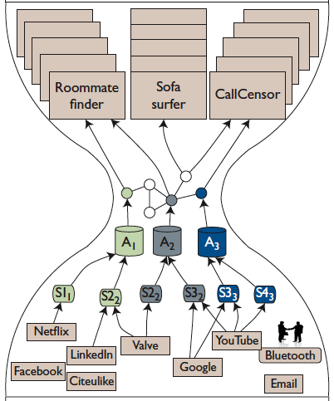
Evolution Towards Social Ecosystems
Applications
Social Inference API
Social Data Management
Personal Aggregators
Social Sensors
Social Signals
Iamnitchi et al. ”The Social Hourglass: an Infrastructure for Socially-aware Applications and Services." IEEE Internet Computing (2012).

Slide 5
Privacy in Social Ecosystems
Social Ecosystems amplify privacy concerns
Aggregated data from different contexts of activity
A more complete (uncomfortable?) digital recording of a person’s life
Social applications from different contexts of activity
Default privacy settings become critical

Slide 6
Privacy as Contextual Integrity
The right to appropriate ﬂow of personal information
Based on two life facts:
transfer of personal information happens in a social context
people alter behavior to correspond with the norms of the context
Two norms:
Norms of appropriateness
Norms of distribution
Nissenbaum, Helen. "Privacy as contextual integrity." Washington Law Review 79.1 (2004).

Slide 7
Our Solution
Ontology-based social ecosystem data model to capture user online data semantics
Model social contexts
Model user roles
Generate default privacy from social data based on Nissembaum’s contextual integrity framework
Extensible, ﬁne-grained default policy customizable by users
Prototype implementation and experimental evaluation on three real-world large networks

Slide 8
Ontology-based Social Ecosystems Data Model
Set of entities, instances, functions, relations and axioms
A vocabulary for social ecosystems
Provides formal and structured representation of user’s data and social spheres
Gives semantic interoperability
High-level logic inference is possible

Slide 10
System Model
Unrestricted set of disjoint social contexts
A user belongs to only one social context at any time
A user can have one or more roles in every social context s/he is part of
Each piece of data (resource) is assigned (created) to only one context
Shared data(resources) are replicated in each of the other users’ current contexts
A request for a resource is made on behalf of the requester’s role in the particular context in which the requester is when the request is made
A request specifies an action, which could be read, write, delete or replicate to another user’s ownership.

Slide 11
Architecture

Slide 12



Policy Specification
A policy is deﬁned as a set of RDF statements
Policies obey the two information norms of CI
Norms of appropriateness: Bob’s colleagues can read his professional groups in the Professional context
Yes
Professional Groups?
No
Colleagues
Alice
Bob
Professional Groups?
ASK
where {
?req rdf:type p:requestor.
?req p:allowed p:read.
p:read p:performedOn Bob.
?req se:isColleagueOf Bob.
Bob se:professionalMember ?group.}
teammate
Charlie

Slide 13
Policy Specification
Norms of distribution: policy restricts the access to Bob’s photos if they are shared
Shared contents
(e.g., Photo)
friends
No
Alice
Bob
Photo?
ASK
where {
?req rdf:type p:requestor.
?req p:allowed p:read.
p:read p:performedOn Bob.
?req se:isFriendOf Bob.
Bob se:hasPhoto ?photo.
?photo se:status se:notShared}
friends
Charlie

Slide 14
Context Inference
Ontology defines hierarchy among resources (user data)
Context inference is possible for each resource

Slide 15
Request Handling Flow Chart

Slide 16
Prototype Implementation
Implemented the prototype in Java Platform Standard Edition 6 (Java SE 6)
Jena’s APIs for RDF data management
Ontology: Jena’s API for handling OWL ontologies
leveraged TDB for persistent storage of knowledge base
SPARQL: Jena’s query engine

Slide 17
Experimental Evaluation
Objective:
Performance of the policy engine in executing default policies for realistic workloads
Scalability of the policy engine in executing default policies
Overhead induced by default policies

Slide 18
Experimental Evaluation
Three real networks
Thirteen test cases (100~70,000 users): snowball sampling from the networks
Social ecosystems knowledge base including Person, Relationships and Groups
Two types of responses
positive authorization access control response
negative authorization access control response

Slide 19
Access time increases linearly with the size of the SEKB
Negative authorization
Positive authorization
Number of requests answered per second

Slide 20
Positive and negative authorization take about the same time
TDB data structures are threaded B+Trees
long scans (negative authorizations) proceeds without needing to traverse the branches of the tree

Slide 21
Performance decreases with increasing users
Increased system memory to realistic capacity for an in-production server
Distributed solutions for data management

Slide 22
Overhead induced by default policies is Statistically Insigniﬁcant

Slide 23
Future Work
Test the effects of default policies
- on applications that are too restrictive
- user satisfaction with user-based surveys
Formalize and analyze potential privacy attacks
Understand the system in different platform settings

Slide 24
Summary
Propose an ontology-based social ecosystem data model to capture user social data
Employ semantic web technologies to generate default privacy polices based on Nissembaum’s contextual integrity theory
Provide an architecture and prototype implementation of privacy model
Experimental evaluation on three real-world large networks to demonstrate the applicability in practice

Slide 25
Thank You!
Aegis: A Semantic Implementation of Privacy as Contextual Integrity in Social Ecosystems
Imrul kayes, Adriana Iamnitchi
http://www.cse.usf.edu/dsg/
imrul@mail.usf.edu

Slide 26
Back Up Slides

Slide 27
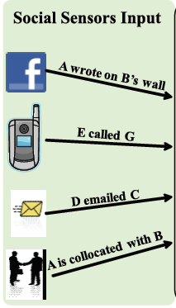
Social Sensors
Consume social signals:
Location/collocation
Schedule (Google calendar)
Mobile phone activity (calls, etc)
Online social network interactions
Email
Shared content (Netflix, CiteULike)
Personal relations (family)
…
Notes:
Social sensors deployed as:
Web applications
Content sharing monitors
Mobile applications
Bluetooth-enabled location recorders
Cell phone-recorded mobility patterns
Bluetooth-enabled collocation
Etc.

Slide 28
Social Sensors
Report on behalf of ego:
Alter, the person ego is interacting with
An activity tag: e.g., “outdoors”, “dining”
Based on content, location, predefined labels, semantic web (ontologies), etc.
A weight: e.g., 0.15
Run on ego’s mobile devices, desktop, or on the web
Process user interactions
To reduce noise
To distinguish between routine and meaningful interactions
Notes:
Examples of social sensors from other studies

Slide 29
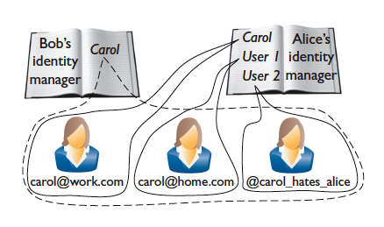
Aggregators
Act as the user’s personal assistant
Runs on trusted device (cell phone)
Responsible for
Managing access to social signal apps
Personalization
Identity management

Slide 30
Related Work
Squicciarini et al. “PriMa”
auto generates access control policies for users
Based on factors such as average privacy preference of similar and related users, accessibility of similar items in similar and related users, closeness of owner and access or popularity of the owner
A large number of factors and their parametrized tuning is required
No performance evaluation

Slide 31
Related Work
Shehab et al. “PolicyMgr”
leverages user provided example policy settings as training sets and build classiﬁers that are the basis for auto-generated policies
Practicality in terms of response time has not yet been shown

Slide 32
Related Work
Our privacy model differs from other solutions
We focused on generating default policies for a social ecosystem that deals with users’ aggregated social data from different domains
We considered a privacy framework proposed by social theorists and translated it into an architecture and proof-of-concept implementation

